Slide 1
Introducing Information Retrieval and Web Search
DTS305TC
Huakang Li
Huakang.li@xjtlu.edu.cn
School of AI and Advanced Computing
Notes:
English Title: Uppercase, Calibri size 60, XJTLU Navy
English Subtitle: Uppercase, Calibri size 36, XJTLU Navy

Slide 2
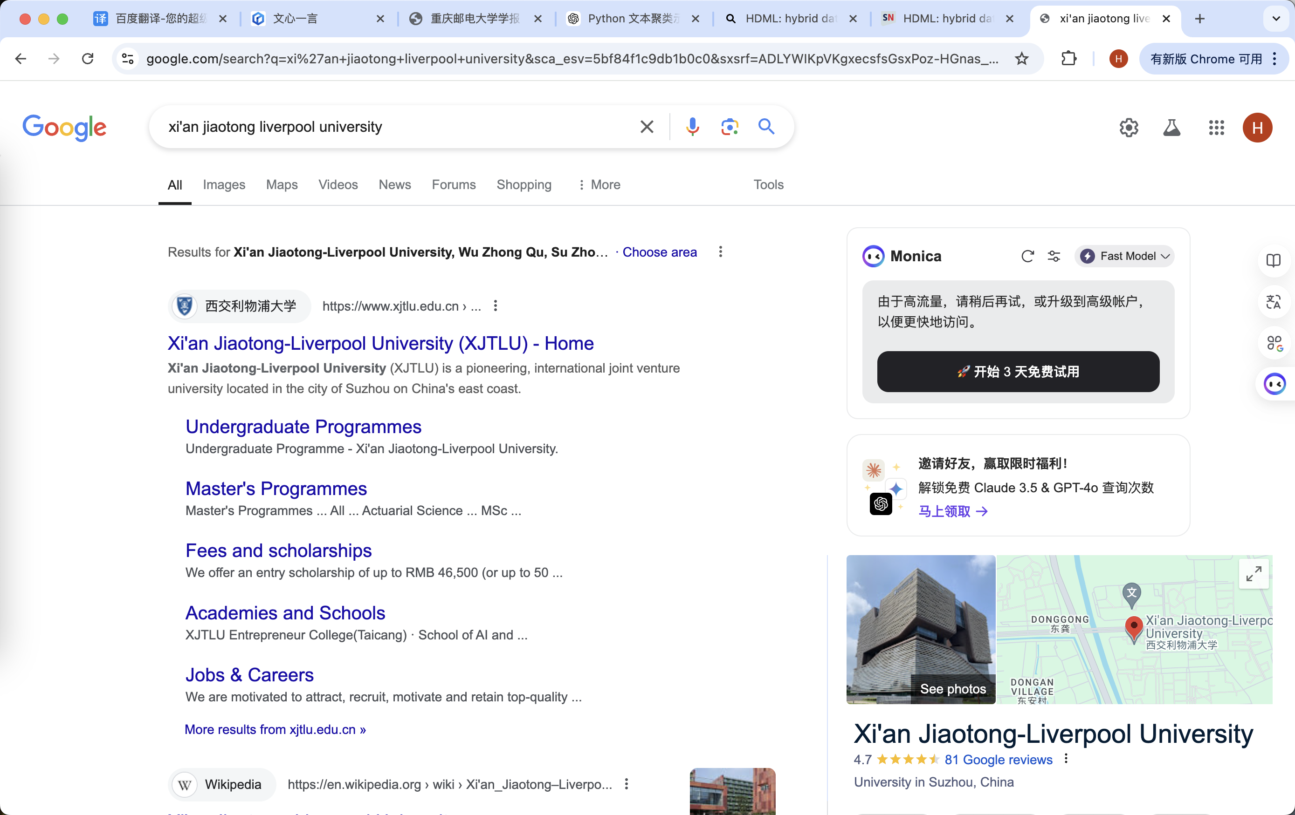
XJTLU on Google
Prompt Based
Team Based
Ontology Based

Slide 3
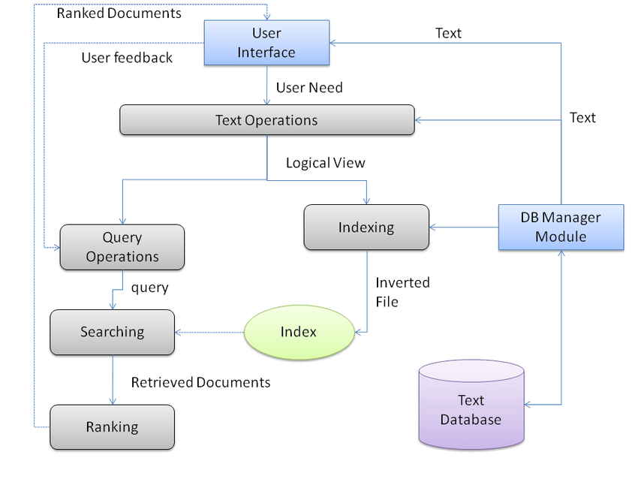
Team based

Slide 4
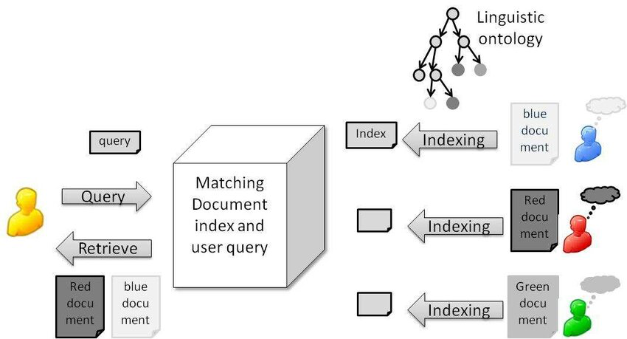
ontology based

Slide 5
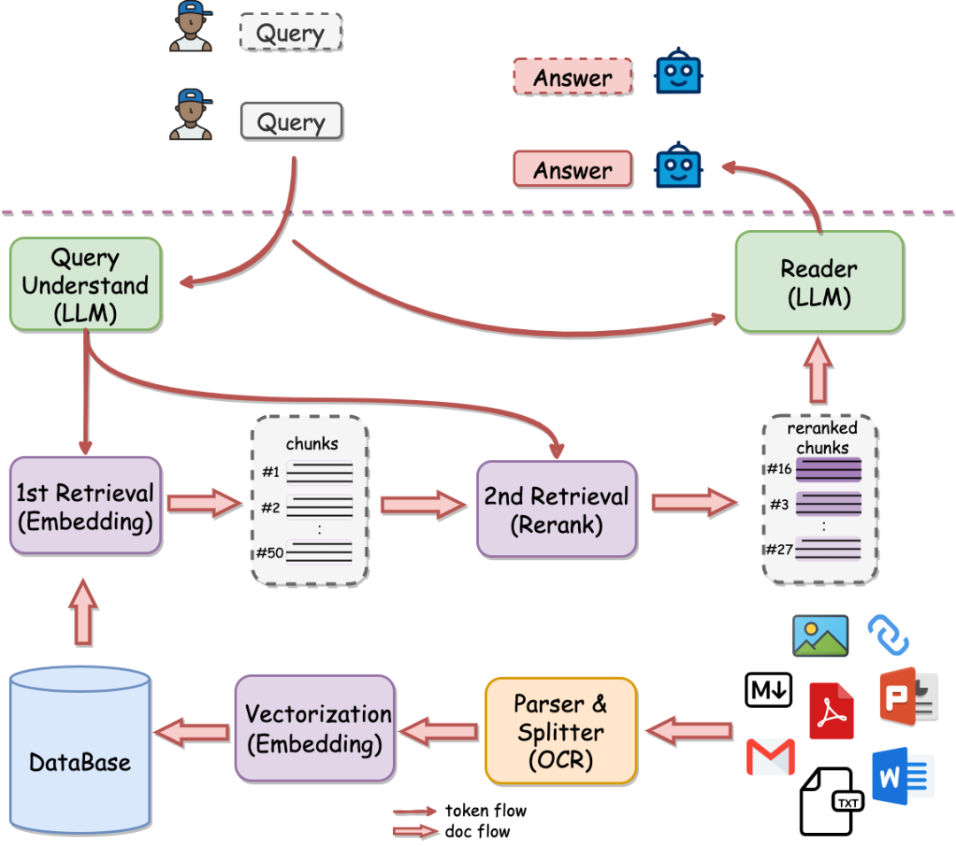
prompt based

Slide 6
Information Retrieval
Information Retrieval (IR) is finding material (usually documents) of an unstructured nature (usually text) that satisfies an information need from within large collections (usually stored on computers).
These days we frequently think first of web search, but there are many other cases:
E-mail search
Searching your laptop
Corporate knowledge bases
Legal information retrieval

Slide 7
Unstructured (text) vs. structured (database) data in the mid-nineties

Slide 8
Unstructured (text) vs. structured (database) data today
Notes:
To the surprise of many, the search box has become the preferred method of information access.
Customers ask: Why can’t I search my database in the same way?

Slide 9
Basic assumptions of Information Retrieval
Sec. 1.1
Collection: A set of documents
Assume it is a static collection for the moment
Goal: Retrieve documents with information that is relevant to the user’s information need and helps the user complete a task

Slide 10
The classic search model
User task
Get rid of mice in a politically correct way
Misconception?
Info need
Info about removing mice
without killing them
Misformulation?
Query
how trap mice alive
Search
Search
engine
Query refinement
Results
Collection

Slide 11
How good are the retrieved docs?
Sec. 1.1
Precision : Fraction of retrieved docs that are relevant to the user’s information need
Recall : Fraction of relevant docs in collection that are retrieved
More precise definitions and measurements to follow later

Slide 12
Term-document incidence matrices
Notes:
English Title: Uppercase, Calibri size 60, XJTLU Navy
English Subtitle: Uppercase, Calibri size 36, XJTLU Navy

Slide 13
Unstructured data in 1620
Sec. 1.1
Which plays of Shakespeare contain the words Brutus AND Caesar but NOT Calpurnia?
One could grep all of Shakespeare’s plays for Brutus and Caesar, then strip out lines containing Calpurnia?
Why is that not the answer?
Slow (for large corpora)
NOT Calpurnia is non-trivial
Other operations (e.g., find the word Romans near countrymen) not feasible
Ranked retrieval (best documents to return)
Later lectures
Notes:
Grep is line-oriented; IR is document oriented.

Slide 14
Term-document incidence matrices
Sec. 1.1
Brutus AND Caesar BUT NOT Calpurnia
1 if play contains word, 0 otherwise

Slide 15
Incidence vectors
Sec. 1.1
So we have a 0/1 vector for each term.
To answer query: take the vectors for Brutus, Caesar and Calpurnia (complemented) ➔ bitwise AND.
110100 AND
110111 AND
101111 =
100100

Slide 16
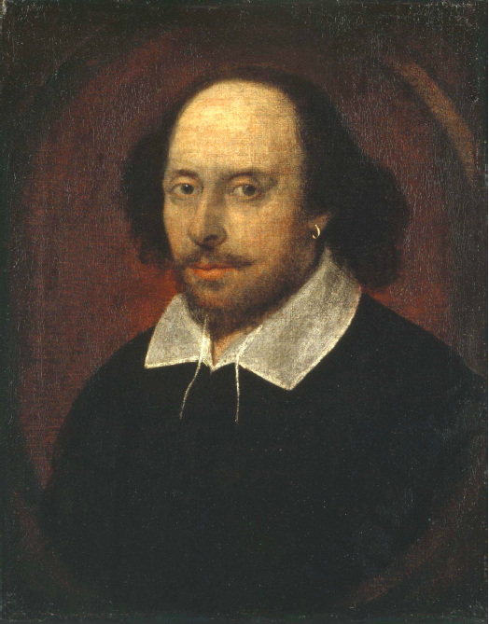
Answers to query
Sec. 1.1
Antony and Cleopatra, Act III, Scene ii
Agrippa [Aside to DOMITIUS ENOBARBUS]: Why, Enobarbus,
When Antony found Julius Caesar dead,
He cried almost to roaring; and he wept
When at Philippi he found Brutus slain.
Hamlet, Act III, Scene ii
Lord Polonius: I did enact Julius Caesar I was killed i’ the
Capitol; Brutus killed me.
Notes:
Wikimedia commons picture of Shake

Slide 17
Bigger collections
Sec. 1.1
Consider N = 1 million documents, each with about 1000 words.
Avg 6 bytes/word including spaces/punctuation
6GB of data in the documents.
Say there are M = 500K distinct terms among these.

Slide 18
Can’t build the matrix
Sec. 1.1
500K x 1M matrix has half-a-trillion 0’s and 1’s.
But it has no more than one billion 1’s.
matrix is extremely sparse.
What’s a better representation?
We only record the 1 positions.
Why?

Slide 19
The Inverted Index The key data structure underlying modern IR
Notes:
English Title: Uppercase, Calibri size 60, XJTLU Navy
English Subtitle: Uppercase, Calibri size 36, XJTLU Navy

Slide 20
Inverted index
Sec. 1.2
For each term t, we must store a list of all documents that contain t.
Identify each doc by a docID, a document serial number
Can we used fixed-size arrays for this?
Brutus
1
2
4
11
31
45
173
174
Caesar
1
2
4
5
6
16
57
132
Calpurnia
2
31
54
101
What happens if the word Caesar is added to document 14?

Slide 21
Inverted index
Sec. 1.2
We need variable-size postings lists
On disk, a continuous run of postings is normal and best
In memory, can use linked lists or variable length arrays
Some tradeoffs in size/ease of insertion
Posting
Brutus
1
2
4
11
31
45
173
174
Caesar
1
2
4
5
6
16
57
132
Calpurnia
2
31
54
101
Dictionary
Postings
Sorted by docID (more later on why).
Notes:
Linked lists generally preferred to arrays
Dynamic space allocation
Insertion of terms into documents easy
Space overhead of pointers

Slide 22

Inverted index construction
Sec. 1.2
Documents to
be indexed
Friends, Romans, countrymen.
Tokenizer
Token stream
Friends
Romans
Countrymen
Linguistic modules
Modified tokens
friend
roman
countryman
Indexer
friend
2
4
roman
1
2
Inverted index
countryman
13
16
Notes:
Document icons from free icon set: http://www.icojoy.com/articles/44/

Slide 23
Inverted index construction
Sec. 1.2
Documents to
be indexed
Friends, Romans, countrymen.
Tokenizer
Token stream
Friends
Romans
Countrymen
More on
these later.
Linguistic modules
Modified tokens
friend
roman
countryman
Indexer
friend
2
4
roman
1
2
Inverted index
countryman
13
16
Notes:
Document icons from free icon set: http://www.icojoy.com/articles/44/

Slide 24
Initial stages of text processing
Tokenization
Cut character sequence into word tokens
Deal with “John’s”, a state-of-the-art solution
Normalization
Map text and query term to same form
You want U.S.A. and USA to match
Stemming
We may wish different forms of a root to match
authorize, authorization
Stop words
We may omit very common words (or not)
the, a, to, of

Slide 25
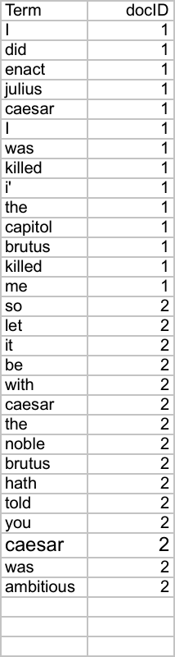
Indexer steps: Token sequence
Sec. 1.2
Sequence of (Modified token, Document ID) pairs.
Doc 1
Doc 2
I did enact Julius
Caesar I was killed
i’ the Capitol;
Brutus killed me.
So let it be with
Caesar. The noble
Brutus hath told you
Caesar was ambitious

Slide 26
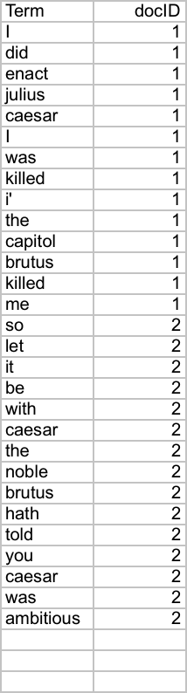
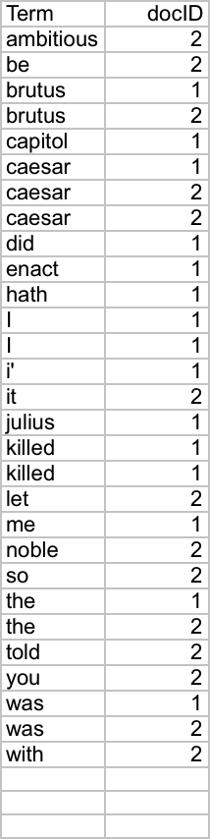
Indexer steps: Sort
Sec. 1.2
Sort by terms
And then docID
Core indexing step

Slide 27
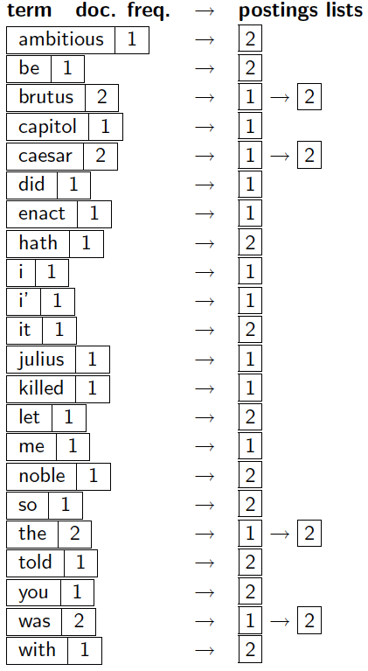
Indexer steps: Dictionary & Postings
Sec. 1.2
Multiple term entries in a single document are merged.
Split into Dictionary and Postings
Doc. frequency information is added.
Why frequency?
Will discuss later.

Slide 28
Where do we pay in storage?
Sec. 1.2
Lists of docIDs
Terms and counts
IR system implementation
How do we index efficiently?
How much storage do we need?
Pointers

Slide 29
Query processing with an inverted index
Notes:
English Title: Uppercase, Calibri size 60, XJTLU Navy
English Subtitle: Uppercase, Calibri size 36, XJTLU Navy

Slide 30
The index we just built
Sec. 1.3
How do we process a query?
Later - what kinds of queries can we process?
Our focus

Slide 31
Query processing: AND
Sec. 1.3
Consider processing the query:
Brutus AND Caesar
Locate Brutus in the Dictionary;
Retrieve its postings.
Locate Caesar in the Dictionary;
Retrieve its postings.
“Merge” the two postings (intersect the document sets):
2
4
8
16
32
64
128
Brutus
1
2
3
5
8
13
21
34
Caesar

Slide 32
The merge
Sec. 1.3
Walk through the two postings simultaneously, in time linear in the total number of postings entries
2
4
8
16
32
64
128
Brutus
1
2
3
5
8
13
21
34
Caesar
If the list lengths are x and y, the merge takes O(x+y)
operations.
Crucial: postings sorted by docID.

Slide 33
The merge
Sec. 1.3
Walk through the two postings simultaneously, in time linear in the total number of postings entries
2
2
4
4
8
8
16
16
32
64
128
32
64
128
Brutus
2
8
1
Caesar
1
2
2
3
5
5
8
8
13
13
21
21
34
3
34
If the list lengths are x and y, the merge takes O(x+y)
operations.
Crucial: postings sorted by docID.

Slide 34
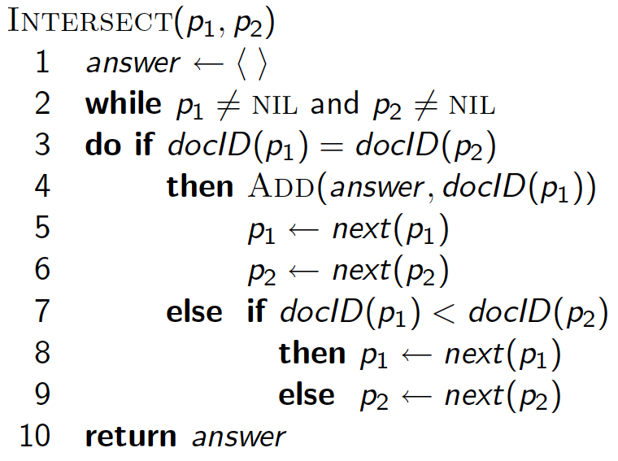
Intersecting two postings lists (a “merge” algorithm)

Slide 35
The Boolean Retrieval Model & Extended Boolean Models
Notes:
English Title: Uppercase, Calibri size 60, XJTLU Navy
English Subtitle: Uppercase, Calibri size 36, XJTLU Navy

Slide 36
Boolean queries: Exact match
Sec. 1.3
The Boolean retrieval model is being able to ask a query that is a Boolean expression:
Boolean Queries are queries using AND, OR and NOT to join query terms
Views each document as a set of words
Is precise: document matches condition or not.
Perhaps the simplest model to build an IR system on
Primary commercial retrieval tool for 3 decades.
Many search systems you still use are Boolean:
Email, library catalog, Mac OS X Spotlight

Slide 37
Example: WestLaw http://www.westlaw.com/
Sec. 1.4
Largest commercial (paying subscribers) legal search service (started 1975; ranking added 1992; new federated search added 2010)
Tens of terabytes of data; ~700,000 users
Majority of users still use boolean queries
Example query:
What is the statute of limitations in cases involving the federal tort claims act?
LIMIT! /3 STATUTE ACTION /S FEDERAL /2 TORT /3 CLAIM
/3 = within 3 words, /S = in same sentence

Slide 38
Example: WestLaw http://www.westlaw.com/
Sec. 1.4
Another example query:
Requirements for disabled people to be able to access a workplace
disabl! /p access! /s work-site work-place (employment /3 place
Note that SPACE is disjunction, not conjunction!
Long, precise queries; proximity operators; incrementally developed; not like web search
Many professional searchers still like Boolean search
You know exactly what you are getting
But that doesn’t mean it actually works better….

Slide 39
Boolean queries: More general merges
Sec. 1.3
Exercise: Adapt the merge for the queries:
Brutus AND NOT Caesar
Brutus OR NOT Caesar
Can we still run through the merge in time O(x+y)? What can we achieve?

Slide 40
Merging
Sec. 1.3
What about an arbitrary Boolean formula?
(Brutus OR Caesar) AND NOT
(Antony OR Cleopatra)
Can we always merge in “linear” time?
Linear in what?
Can we do better?

Slide 41
Query optimization
Sec. 1.3
What is the best order for query processing?
Consider a query that is an AND of n terms.
For each of the n terms, get its postings, then AND them together.
Brutus
2
4
8
16
32
64
128
Caesar
1
2
3
5
8
16
21
34
Calpurnia
13
16
Query: Brutus AND Calpurnia AND Caesar

Slide 42
Query optimization example
Sec. 1.3
Process in order of increasing freq:
start with smallest set, then keep cutting further.
This is why we kept
document freq. in dictionary
Brutus
2
4
8
16
32
64
128
Caesar
1
2
3
5
8
16
21
34
Calpurnia
13
16
Execute the query as (Calpurnia AND Brutus) AND Caesar.

Slide 43
More general optimization
Sec. 1.3
e.g., (madding OR crowd) AND (ignoble OR strife)
Get doc. freq.’s for all terms.
Estimate the size of each OR by the sum of its doc. freq.’s (conservative).
Process in increasing order of OR sizes.

Slide 44
Query processing exercises
Exercise: If the query is friends AND romans AND (NOT countrymen), how could we use the freq of countrymen?
Exercise: Extend the merge to an arbitrary Boolean query. Can we always guarantee execution in time linear in the total postings size?
Hint: Begin with the case of a Boolean formula query: in this, each query term appears only once in the query.

Slide 45
Phrase queries and positional indexes
Notes:
English Title: Uppercase, Calibri size 60, XJTLU Navy
English Subtitle: Uppercase, Calibri size 36, XJTLU Navy

Slide 46
Phrase queries
Sec. 2.4
We want to be able to answer queries such as “stanford university” – as a phrase
Thus the sentence “I went to university at Stanford” is not a match.
The concept of phrase queries has proven easily understood by users; one of the few “advanced search” ideas that works
Many more queries are implicit phrase queries
For this, it no longer suffices to store only
<term : docs> entries

Slide 47
A first attempt: Biword indexes
Sec. 2.4.1
Index every consecutive pair of terms in the text as a phrase
For example the text “Friends, Romans, Countrymen” would generate the biwords
friends romans
romans countrymen
Each of these biwords is now a dictionary term
Two-word phrase query-processing is now immediate.

Slide 48
Longer phrase queries
Sec. 2.4.1
Longer phrases can be processed by breaking them down
stanford university palo alto can be broken into the Boolean query on biwords:
stanford university AND university palo AND palo alto
Without the docs, we cannot verify that the docs matching the above Boolean query do contain the phrase.
Can have false positives!

Slide 49
Extended biwords
Sec. 2.4.1
Parse the indexed text and perform part-of-speech-tagging (POST).
Bucket the terms into (say) Nouns (N) and articles/prepositions (X).
Call any string of terms of the form NX*N an extended biword.
Each such extended biword is now made a term in the dictionary.
Example: catcher in the rye
N X X N
Query processing: parse it into N’s and X’s
Segment query into enhanced biwords
Look up in index: catcher rye

Slide 50
Issues for biword indexes
Sec. 2.4.1
False positives, as noted before
Index blowup due to bigger dictionary
Infeasible for more than biwords, big even for them
Biword indexes are not the standard solution (for all biwords) but can be part of a compound strategy

Slide 51
Solution 2: Positional indexes
Sec. 2.4.2
In the postings, store, for each term the position(s) in which tokens of it appear:
<term, number of docs containing term;
doc1: position1, position2 … ;
doc2: position1, position2 … ;
etc.>

Slide 52
Positional index example
Sec. 2.4.2
<be: 993427;
1: 7, 18, 33, 72, 86, 231;
2: 3, 149;
4: 17, 191, 291, 430, 434;
5: 363, 367, …>
Which of docs 1,2,4,5
could contain “to be
or not to be”?
For phrase queries, we use a merge algorithm recursively at the document level
But we now need to deal with more than just equality

Slide 53
Processing a phrase query
Sec. 2.4.2
Extract inverted index entries for each distinct term: to, be, or, not.
Merge their doc:position lists to enumerate all positions with “to be or not to be”.
to:
2:1,17,74,222,551; 4:8,16,190,429,433; 7:13,23,191; ...
be:
1:17,19; 4:17,191,291,430,434; 5:14,19,101; ...
Same general method for proximity searches

Slide 54
Proximity queries
Sec. 2.4.2
LIMIT! /3 STATUTE /3 FEDERAL /2 TORT
Again, here, /k means “within k words of”.
Clearly, positional indexes can be used for such queries; biword indexes cannot.
Exercise: Adapt the linear merge of postings to handle proximity queries. Can you make it work for any value of k?
This is a little tricky to do correctly and efficiently
See Figure 2.12 of IIR

Slide 55
Positional index size
Sec. 2.4.2
A positional index expands postings storage substantially
Even though indices can be compressed
Nevertheless, a positional index is now standardly used because of the power and usefulness of phrase and proximity queries … whether used explicitly or implicitly in a ranking retrieval system.

Slide 56
Positional index size
Sec. 2.4.2
Need an entry for each occurrence, not just once per document
Index size depends on average document size
Average web page has <1000 terms
SEC filings, books, even some epic poems … easily 100,000 terms
Consider a term with frequency 0.1%
Why?
Document size
Postings
Positional postings
1000
1
1
100,000
1
100

Slide 57
Rules of thumb
Sec. 2.4.2
A positional index is 2–4 as large as a non-positional index
Positional index size 35–50% of volume of original text
Caveat: all of this holds for “English-like” languages

Slide 58
Combination schemes
Sec. 2.4.3
These two approaches can be profitably combined
For particular phrases (“Michael Jackson”, “Britney Spears”) it is inefficient to keep on merging positional postings lists
Even more so for phrases like “The Who”
Williams et al. (2004) evaluate a more sophisticated mixed indexing scheme
A typical web query mixture was executed in ¼ of the time of using just a positional index
It required 26% more space than having a positional index alone

Slide 59



THANK YOU
Visit us
FOLLOW us
www.xjtlu.edu.cn
Notes:
Title: Uppercase, Calibri size 60, XJTLU Navy

